Slide 1


Turas Analytics Engine

Slide 2
What is Turas?
Research Analysis That Works the Way You Do
Research analysis is slow, inconsistent, and hard to defend. Analysts rebuild the same crosstabs from scratch. Methods vary by project. Outputs can't be audited. And when a client pushes back on a finding, there's no clean trail to follow.
Turas fixes that. It's a controlled, reproducible analytics platform built for survey research — combining world-class statistical methods with a structured workflow that delivers automated, consistent, and fully auditable analysis every time.
Automated — No manual rebuilds
Consistent methodology every time
Auditable — Full trail of evidence

Slide 3
Why You Can Trust It
Built on Proven, Transparent Methods
Turas is built on mature R packages with over 400 million downloads — not proprietary black-box algorithms. The underlying TRS framework adds a critical layer: no silent failures, full reproducibility, and complete auditability.
Every analytical output can be traced back to its methodology.
No black boxes — just transparent, reproducible analysis.
400M+ Downloads
Full Reproducibility
Auditability
Built on proven, mature R packages
Every analysis runs the same way, every time
Trace any output back to the table

Slide 4



Why HTML Reports Are the Future
From Static Slides to Interactive Insights
Static PowerPoint decks go stale the moment they leave the analyst's hands. Turas HTML reports change that.
One Source of Truth
Explore & Drill Down
Lasting Confidence
Produced directly from the analysis — interactive, shareable, and reusable
Decision-makers can explore the data themselves and drill into what matters
Return to the same report weeks later with full confidence in what you're seeing

Slide 5
What Turas Can Do
Analysis Modules
Tabs
Tracker
Key Driver
Key Driver (Cat.)
Automated crosstabs with frequency, column %, row %, significance testing & weighting.
Multi-wave trend analysis with significance testing and question mapping across waves.
Identifies factors with the strongest statistical relationship to key business outcomes.
Regression methods for categorical outcomes — purchase decisions, segments, or tiers.
Segment
Conjoint
MaxDiff
Pricing
Statistical clustering to discover natural customer groups beyond broad averages.
Discrete choice modelling with an Excel-based interactive market simulator.
Precise preference rankings from balanced best/worst item sets.
Price sensitivity analysis using Van Westendorp & Gabor-Granger models.
Current operational modules (with more in development)
Supporting Modules
Weighting — ensures data represents your target population | Confidence — rigorous validity testing beyond standard significance flags

Slide 6



From Analysis to Action
A Powerful Analytics Capability. Yours to Own.
White-Label Ready
Bring Turas into your practice, under your brand, and use it directly with your clients.
No Overhead Required
Offer rigorous quantitative research — key drivers, segmentation, conjoint, trackers — without building methodology from scratch or hiring specialist analysts.
Immediate Client Value
Faster turnaround, interactive reports they can actually use, and findings built on defensible, peer-reviewed methodology — not a black box.
Turas adds a high-value analytics capability to your practice without the overhead of building one.

Slide 7
Sample Slides from Turas
Demonstrating report pin outputs

Slide 8
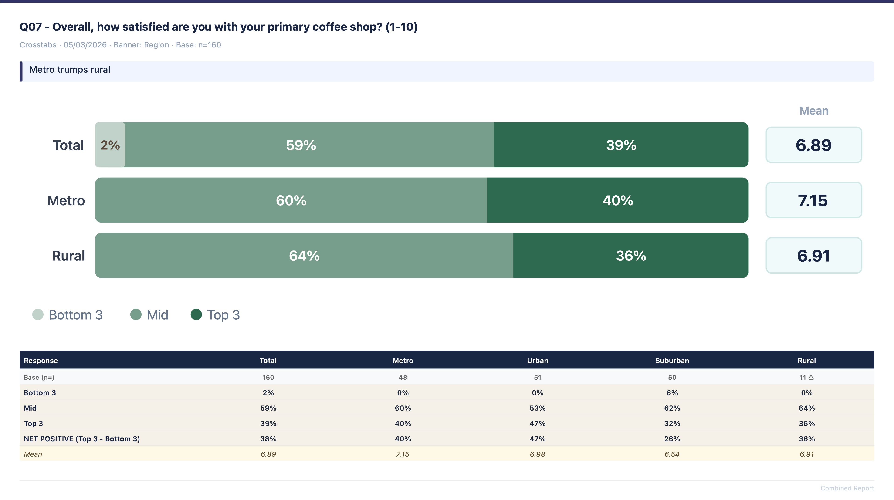
Overall satisfaction

Slide 9
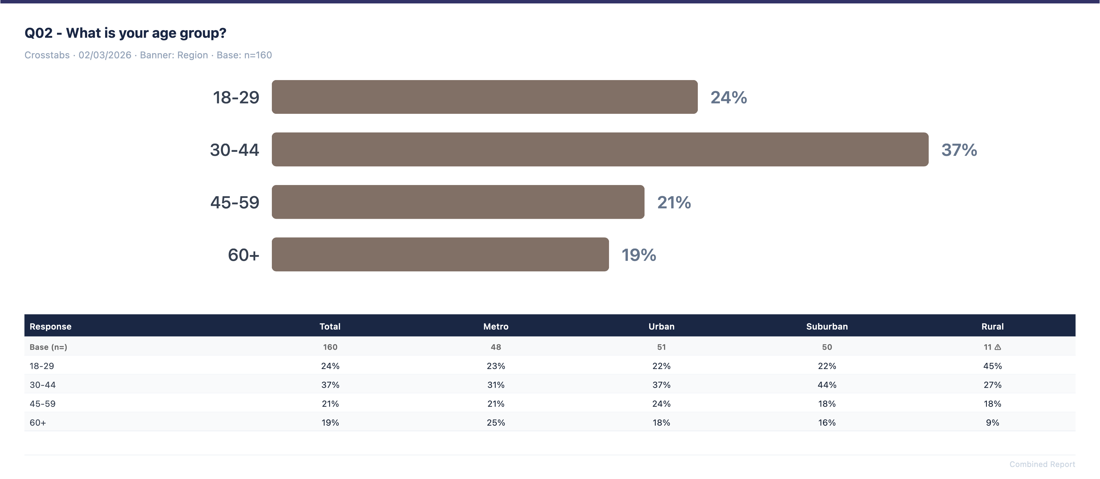
Age by region

Slide 10
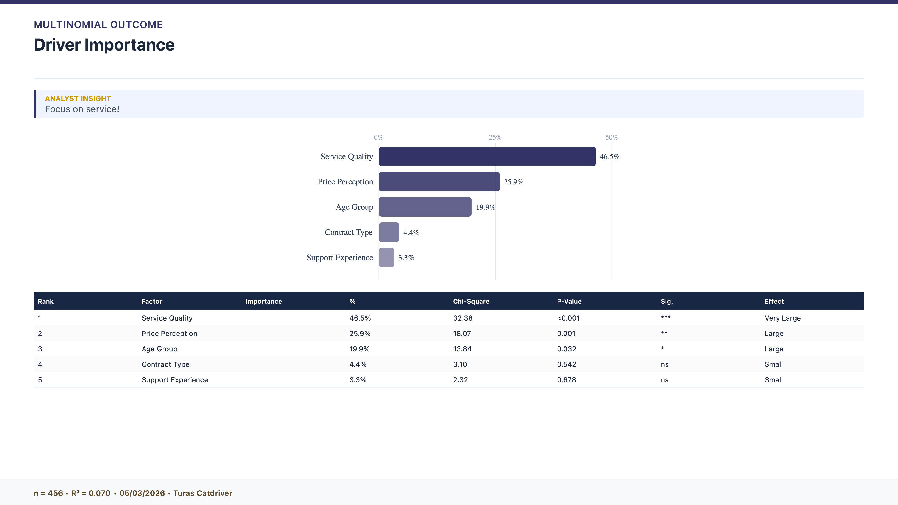
What is driving satisfaction

Slide 11
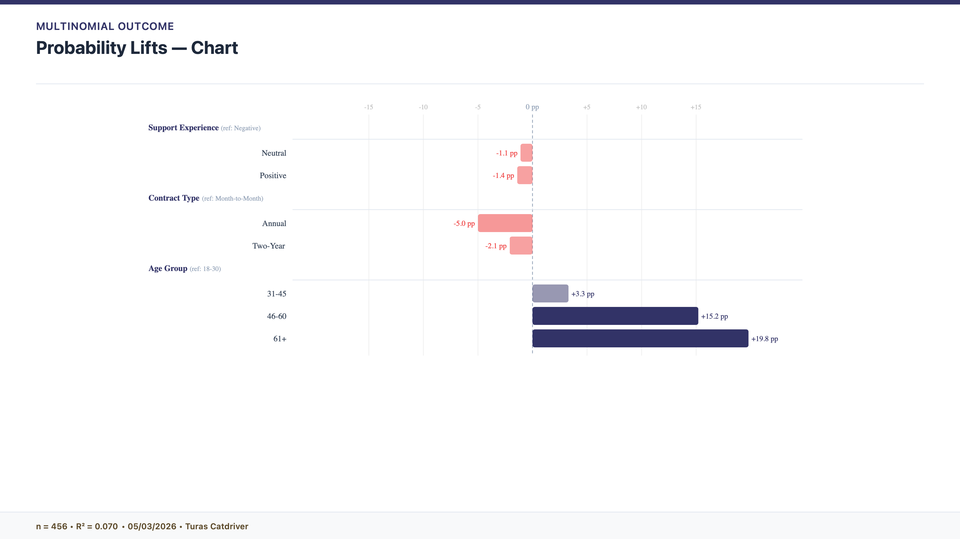
The older you are the higher the chances of satisfaction

Slide 12
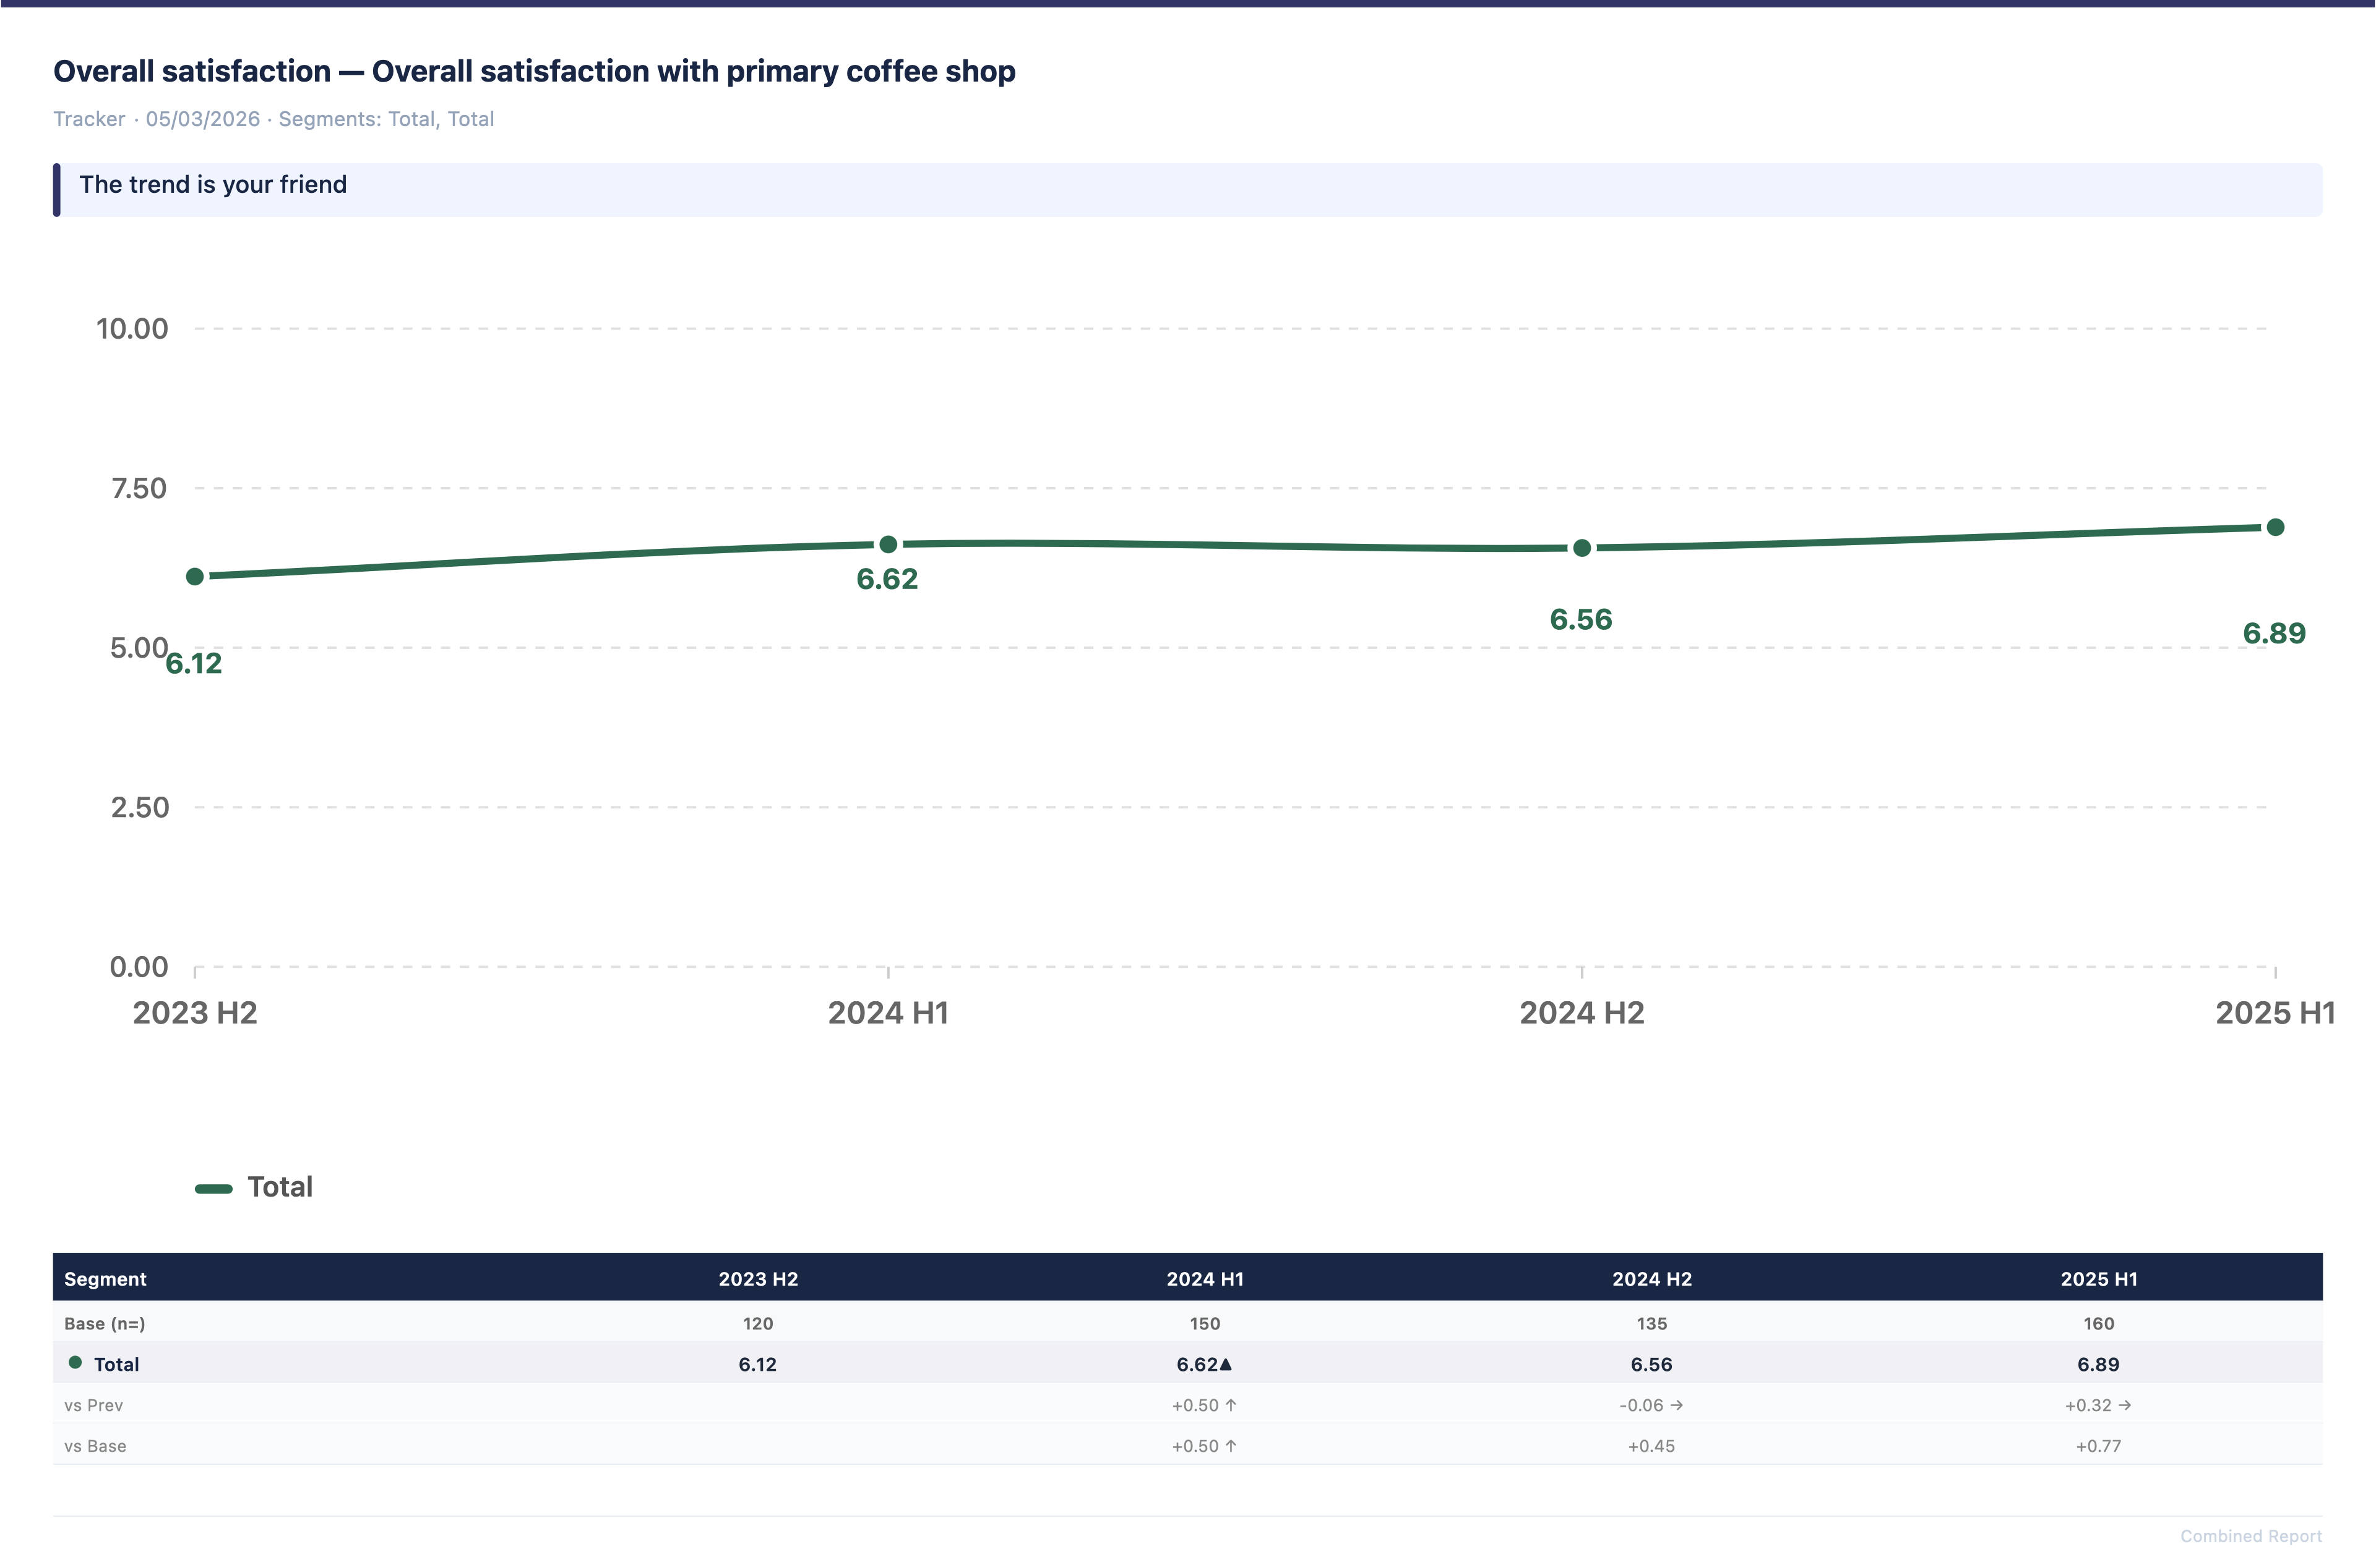
Cross wave comparison

Slide 13
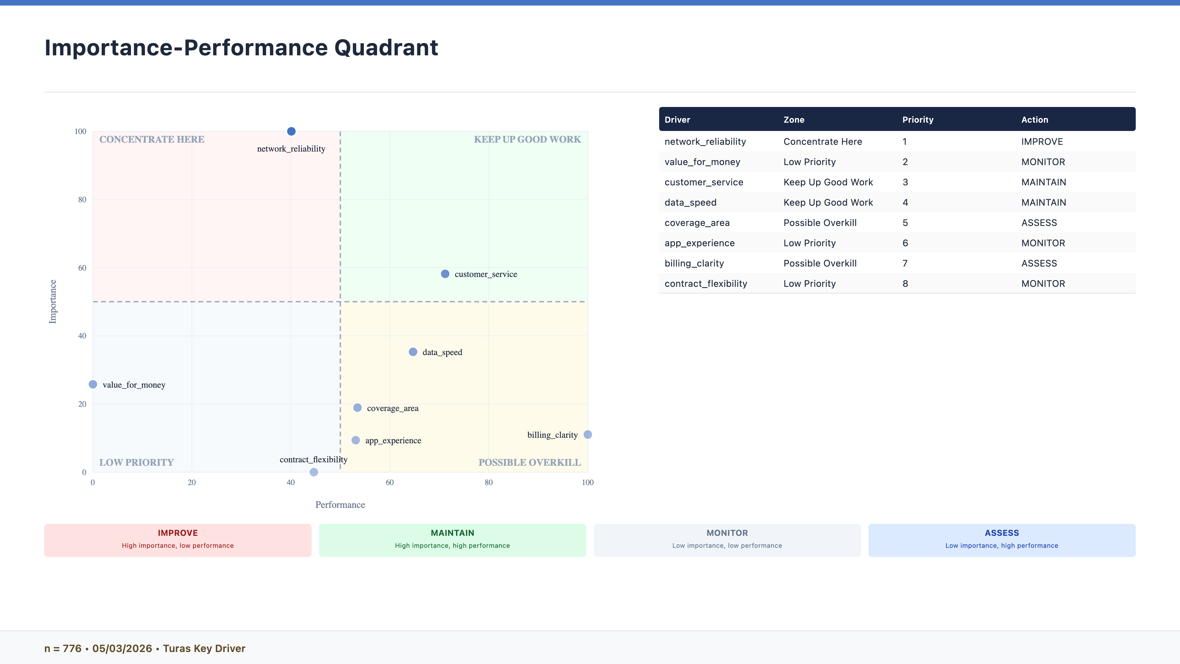
Importance performance maps

Slide 14
Thank You
Reproducible research analysis, delivered.

